Slide 1
Nitrogen fixation in legumes
Metabolic regulation and agricultural impact

Slide 2
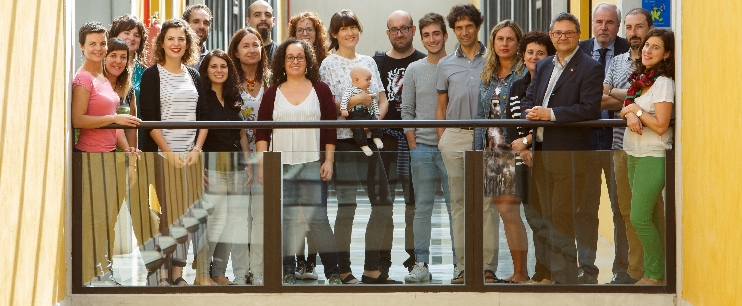
The research group

Slide 3
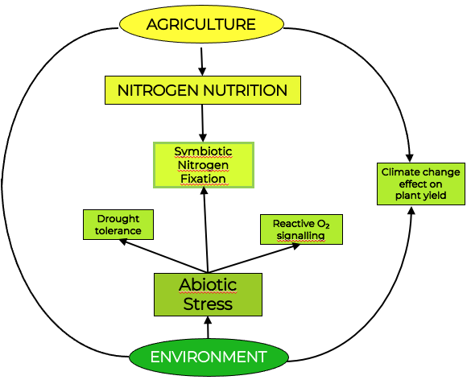
Plant Physiology and Agrobiology group
Research interests:
To understand how plants interact with the environment from a molecular physiology perspective with the goal of a more sustainable agriculture
Main topic: abiotic stress and regulation of the legume-Rhizobium symbiosis

Slide 4
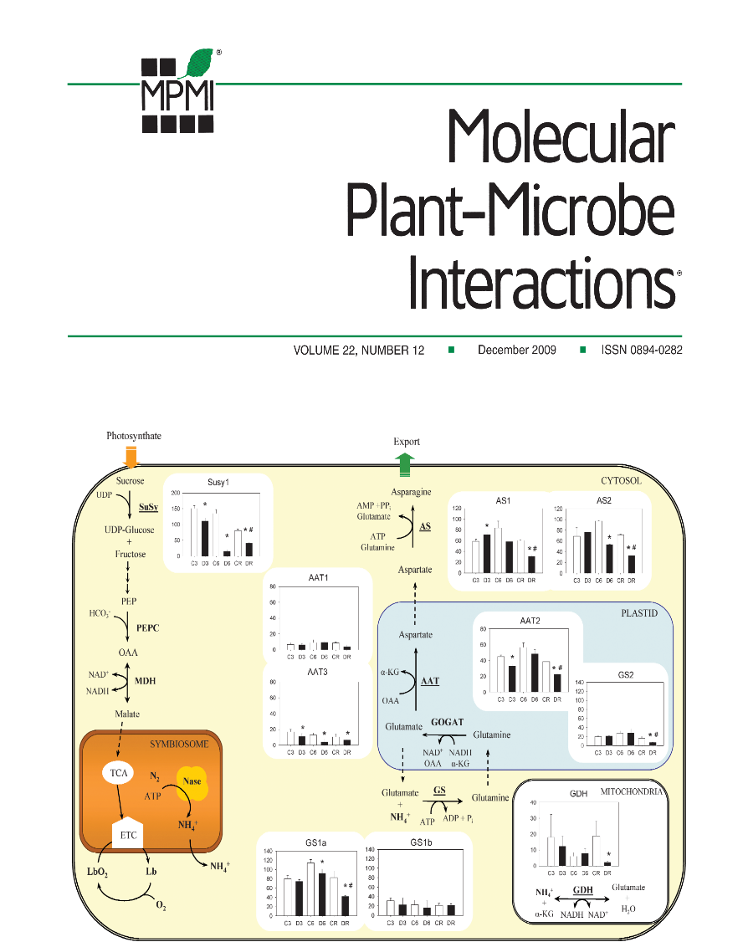
Cesar Arrese-Igor
(Publons profile)
(UPNa profile)
Estíbaliz Larrainzar
(Scopus profile)
(UPNa profile)

Slide 5
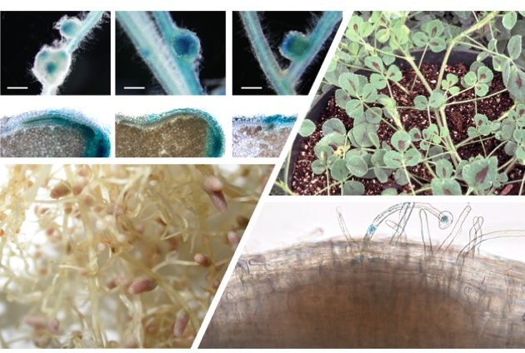
Research project: role of ethylene in the regulation of the legume-Rhizobium symbiosis
What?
  Plant-microbe interactions, molecular biology, plant physiology, gene expression (RNA-seq), microscopy, proteomics, functional analysis
Where?
  UPNA and Blue Agro Bioscience (Spain), CNRS-INRA (France), University of Vienna (Austria)
What else?
  Friendly work environment, support for career development, training in a diversity of techniques and skills, international network

Slide 6
See you soon!

